Slide 1


Smart Mobility Engineering Lab (IGS3231) Week 2 Lecture
ISE Department
Prof. Mehdi Pirahandeh

Slide 2
Content
Introduction to Embedded System Design
Application Examples
Q & A
Survey

Slide 3
Enabling topic statistics(C++)
Goal: Enable ROS 2 Topic Statistics and view the output statistics data.
ROS 2 provides the integrated measurement of statistics for messages received by any subscription, called Topic Statistics. With Topic Statistics enabled for your subscription, you can characterize the performance of your system or use the data to help diagnose any present issues.
Step 1: Write the subscriber node with statistics enabled
Navigate into the ros2_ws/src/cpp_pubsub/src folder, created in the previous tutorial, and download the example talker code by entering the following command:
wget -O member_function_with_topic_statistics.cpp https://raw.githubusercontent.com/ros2/examples/foxy/rclcpp/topics/minimal_subscriber/member_function_with_topic_statistics.cpp
Step 2: Build and run
To build, see the Build and run section in the pub/sub tutorial.
Run the subscriber with statistics enabled node:
ros2 run cpp_pubsub listener_with_topic_statistics
Now run the talker node:
ros2 run cpp_pubsub talker

Slide 4

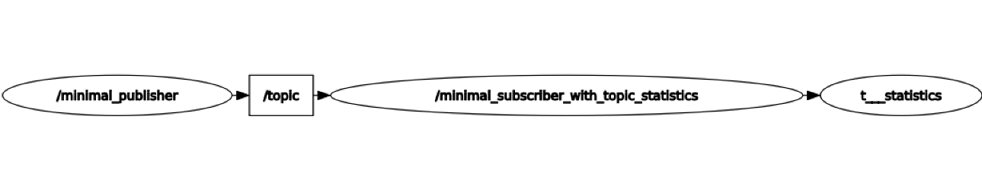
Enabling topic statistics(C++)
Step 3: Observe published statistics data
While the nodes are running, open a new terminal window. Execute the following command:
ros2 topic list
This will list all currently active topics. You should see the following:
If you optionally changed the topic_stats_options.publish_topic field earlier in the tutorial, then you will see that name instead of /statistics.
The subscriber node you created is publishing statistics, for the topic topic, to the output topic /statistics.
We can visualize this using RQt

Slide 5
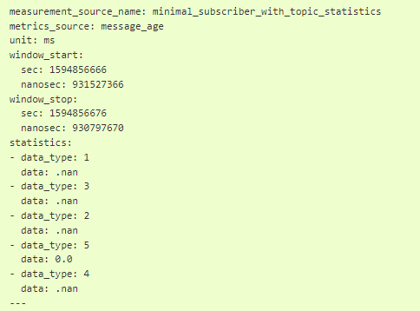
Enabling topic statistics(C++)
Now we can view the statistics data published to this topic with the following command:
ros2 topic echo /statistics\
The terminal should start publishing statistics messages every 10 seconds, because the topic_stats_options.publish_period subscription configuration was optionally changed earlier in the tutorial.

Slide 6
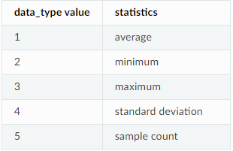
Enabling topic statistics(C++)
From the message definition the data_types are as follows
Here we see the two currently possible calculated statistics for the std_msgs::msg::String message published to /topic by the minimal_publisher. Because the std_msgs::msg::String does not have a message header, the message_age calculation cannot be performed, so NaNs are returned. However, the message_period can be calculated and we see the statistics populated in the message above.

Slide 7
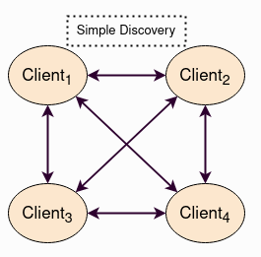
Using Fast DDS Discovery Server as discovery protocol
Goal: This tutorial will show how to launch ROS 2 Nodes using the Fast DDS Discovery Server discovery protocol.
The Fast DDS Discovery Server protocol is a feature that offers a centralized dynamic discovery mechanism, as opposed to the distributed mechanism used in DDS by default. This tutorial explains how to run some ROS 2 examples using the Fast DDS Discovery Server feature as discovery communication.
The Simple Discovery Protocol is the standard protocol defined in the DDS standard. However, it has known disadvantages in some scenarios.
It does not Scale efficiently, as the number of exchanged packets increases significantly as new nodes are added.
It requires multicasting capabilities that may not work reliably in some scenarios, e.g. WiFi.

Slide 8
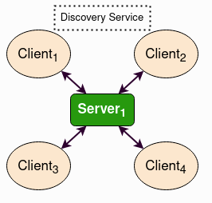
Using Fast DDS Discovery Server as discovery protocol
The Fast DDS Discovery Server provides a Client-Server Architecture that allows nodes to connect with each other using an intermediate server. Each node functions as a discovery client, sharing its info with one or more discovery servers and receiving discovery information from it. This reduces discovery-related network traffic, and it does not require multicasting capabilities.
These discovery servers can be independent, duplicated or connected with each other in order to create redundancy over the network and avoid having a single point of failure.

Slide 9
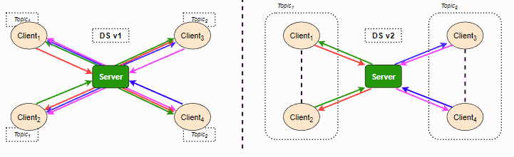
Using Fast DDS Discovery Server as discovery protocol
Fast DDS Discovery Server v2
The latest ROS 2 Foxy Fitzroy release (December 2020) included a new version, version 2 of the Fast DDS Discovery Server. This version includes a new filter feature that further reduces the number of discovery messages sent. This version uses the topic of the different nodes to decide if two nodes wish to communicate, or if they can be left unmatched (i.e. not discovering each other). The following figure shows the decrease in discovery messages:
This architecture reduces the number of messages sent between the server and clients dramatically.

Slide 10
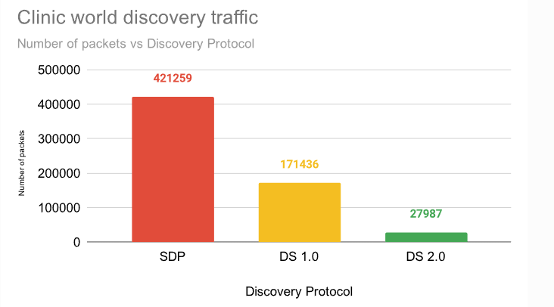
Using Fast DDS Discovery Server as discovery protocol
In the following graph, the reduction in network traffic over the discovery phase for the RMF Clinic demonstration is shown:
In order to use this functionality, the discovery server can be configured using the XML configuration for Participants. It is also possible to configure the discovery server using the fastdds tool and an environment variable, which is the approach used in this tutorial. For a more detailed explanation about the configuration of the discovery server, visit the Fast DDS Discovery Server documentation.

Slide 11
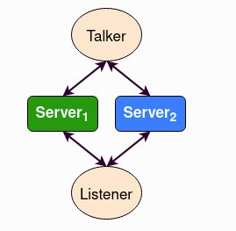
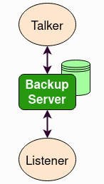
Using Fast DDS Discovery Server as discovery protocol
Server Redundancy
By using fastdds tool, multiple discovery servers can be created. Discovery clients (ROS nodes) can connect to as many servers as desired. This allows to have a redundant network that will work even if some servers or nodes shut down unexpectedly.
Backup Server
The Fast DDS Discovery Server allows creating a server with backup functionality. This allows the server to restore the last state it saved in case of a shutdown.

Slide 12
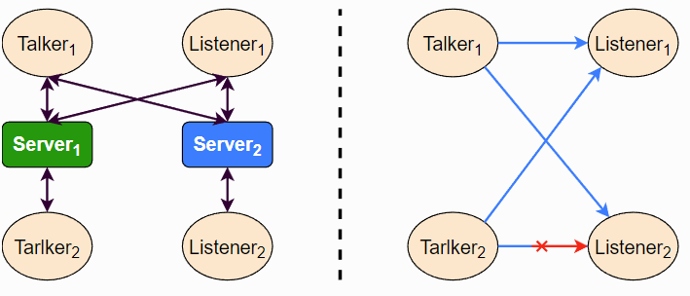
Using Fast DDS Discovery Server as discovery protocol
Discovery partitions
Communication with discovery servers can be split to create virtual partitions in the discovery information. This means that two endpoints will only know about each other if there is a shared discovery server or a network of discovery servers between them. We are going to execute an example with two independent servers.
With this schema Listener 1 will be connected to Talker 1 and Talker 2, as they share Server 1. Listener 2 will connect with Talker 1 as they share Server 2. But Listener 2 will not hear the messages from Talker 2 because they do not share any discovery server or discovery servers, including indirectly via connections between redundant discovery servers.

Slide 13

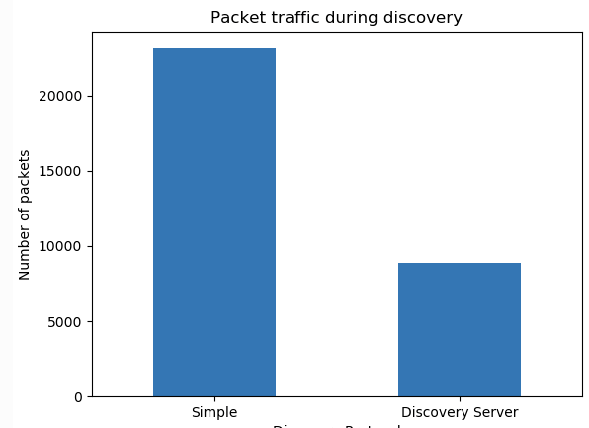
Using Fast DDS Discovery Server as discovery protocol
Note
Compare Fast DDS Discovery Server with Simple Discovery Protocol
In order to compare executing nodes using the Simple Discovery Protocol or the discovery server, two scripts that execute a talker and many listeners and analyze the network traffic during this time are provided. For this experiment, tshark is required to be installed on your system. The configuration file is mandatory in order to avoid using intraprocess mode.
Run the bash script with the path to setup.bash file to source ROS 2 as an argument. This will generate the traffic trace for simple discovery. Execute the same script with second argument SERVER. It will generate the trace for using the discovery server.

Slide 14
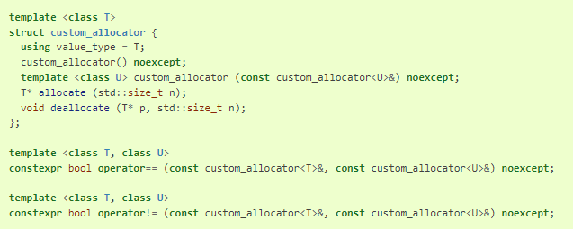
Implementing a custom memory allocator
Goal: This tutorial will show how to use a custom memory allocator when writing ROS 2 C++ code.
Step 1: Writing an allocator
The C++11 library provides something called allocator_traits. The C++11 standard specifies that a custom allocator only needs to fulfil a minimal set of requirements to be used to allocate and deallocate memory in a standard way. allocator_traits is a generic structure that fills out other qualities of an allocator based on an allocator written with the minimal requirements.
For example, the following declaration for a custom allocator would satisfy allocator_traits

Slide 15
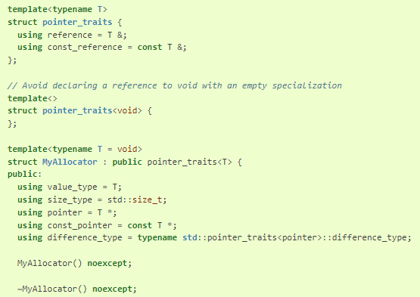
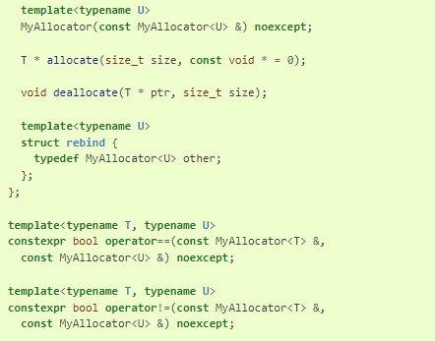
Implementing a custom memory allocator
However, some compilers that only have partial C++11 support, such as GCC 4.8, still require allocators to implement a lot of boilerplate code to work with standard library structures such as vectors and strings, because these structures do not use allocator_traits internally. Therefore, if you’re using a compiler with partial C++11 support, your allocator will need to look more like this:

Slide 16
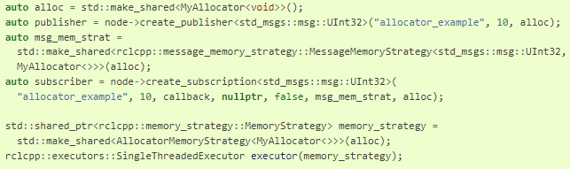
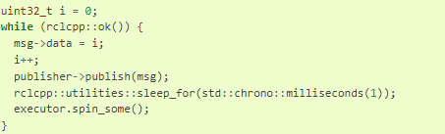
Implementing a custom memory allocator
Writing an example main
Once you have written a valid C++ allocator, you must pass it as a shared pointer to your publisher, subscriber, and executor.
You will also need to use your allocator to allocate any messages that you pass along the execution codepath.
auto alloc = std::make_shared<MyAllocator<void>>();
Once you’ve instantiated the node and added the executor to the node, it’s time to spin:

Slide 17
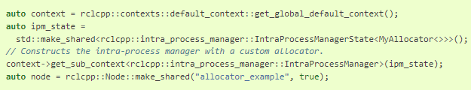
Passing an allocator to the intra-process pipeline
The IntraProcessManager is a class that is usually hidden from the user, but in order to pass a custom allocator to it we need to expose it by getting it from the rclcpp Context. The IntraProcessManager makes use of several standard library structures, so without a custom allocator it will call the default new.
Testing and Verifying the code
How do you know that your custom allocator is actually getting called?
The obvious thing to do would be to count the calls made to your custom allocator’s allocate and deallocate functions and compare that to the calls to new and delete.

Slide 18

Recording a bag from a node
Goal: Record data from your own node to a bag.
rosbag2 doesn’t just provide the ros2 bag command line tool. It also provides an API for reading from and writing to a bag from your own source code. This allows you to subscribe to a topic and save the received data to a bag at the same time as performing any other processing of your choice on that data.
Step 1: Create a package
Navigate into the ros2_ws/src directory and create a new package:
ros2 pkg create --build-type ament_cmake bag_recorder_nodes --dependencies rclcpp rosbag2_cpp example_interfaces
Your terminal will return a message verifying the creation of your package bag_recorder_nodes and all its necessary files and folders. The --dependencies argument will automatically add the necessary dependency lines to package.xml and CMakeLists.txt.
Step 1.1 Update package.xml
As always, though, make sure to add the description, maintainer email and name, and license information to package.xml.

Slide 19
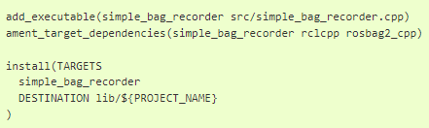
Recording a bag from a node
Step 2.2 : Add executable
Now open the CMakeLists.txt file. Below the dependency find_package(rosbag2_cpp REQUIRED) add the following lines of code.
Step 3: Build and run
Navigate back to the root of your workspace, ros2_ws, and build your new package.
colcon build --packages-select bag_recorder_nodes
Open a new terminal, navigate to ros2_ws, and source the setup files.
source install/setup.bash
Create a directory for the bag. This directory will contain all the files that form a single bag.
mkdir my_bag
Now run the node:
ros2 run bag_recorder_nodes simple_bag_recorder
Open a second terminal and run the talker example node.
ros2 run demo_nodes_cpp talker
Terminate both nodes. Then, in one terminal start the listener example node.
ros2 run demo_nodes_cpp listener
In the other terminal, use ros2 bag to play the bag recorded by your node.
ros2 bag play my_bag

Slide 20
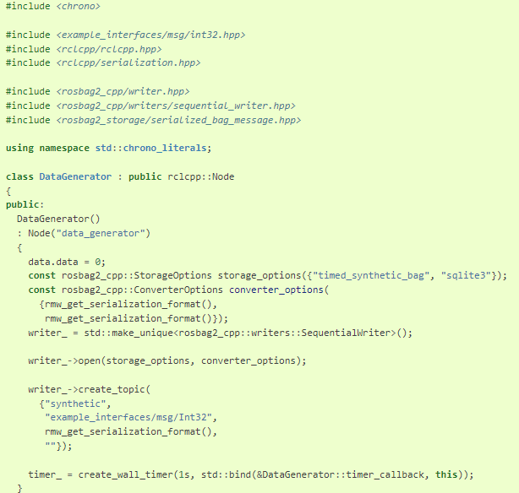
Recording a bag from a node
Step 4: Record synthetic data from a node
Any data can be recorded into a bag, not just data received over a topic. A common use case for writing to a bag from your own node is to generate and store synthetic data.
Step 4.1: Write a C++ node
Inside the ros2_ws/src/bag_recorder_nodes/src directory, create a new file called data_generator_node.cpp
and paste the following code into it.

Slide 21
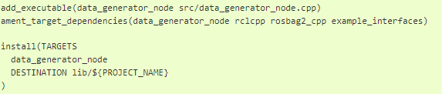
Recording a bag from a node
Step 4.3 : Add executable
Open the CMakeLists.txt file and add the following lines after the previously-added lines (specifically, after the install(TARGETS ...) macro call).
Step 4.4: Build and run
Navigate back to the root of your workspace, ros2_ws, and build your package.
colcon build --packages-select bag_recorder_nodes
Open a new terminal, navigate to ros2_ws, and source the setup files.
source install/setup.bash
Create a directory for the bag. This directory will contain all the files that form a single bag.
mkdir timed_synthetic_bag
Now run the node:
ros2 run bag_recorder_nodes data_generator_node
Wait for 30 seconds or so, then terminate the node with ctrl-c. Next, play back the created bag.
ros2 bag play timed_synthetic_bag
Open a second terminal and echo the /synthetic topic.
ros2 topic echo /synthetic

Slide 22

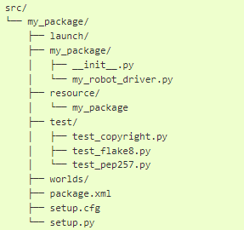
Setting up a robot simulation
Goal: Setup a robot simulation and control it from ROS 2.
Several robot simulators can be used with ROS 2, such as Gazebo, Ignition, Webots, etc. Unlike turtlesim, they provide fairly realistic results relying on physics-based models for robots, sensors, actuators and objects.
Step 1: Create the package structure
Let’s organize the code in a custom ROS 2 package. Create a new package named my_package from the src folder of your ROS 2 workspace. Change the current directory of your terminal to ros2_ws/src and run:
ros2 pkg create --build-type ament_python --node-name my_robot_driver my_package --dependencies rclpy geometry_msgs webots_ros2_driver
The --node-name my_robot_driver option will create a my_robot_driver.py template Python plugin in the my_package subfolder that you will modify later. The --dependencies rclpy geometry_msgs webots_ros2_driver option specifies the packages needed by the my_robot_driver.py plugin in the package.xml file. Let’s add a launch and a worlds folder inside the my_package folder.
You should end up with the following folder structure:

Slide 23
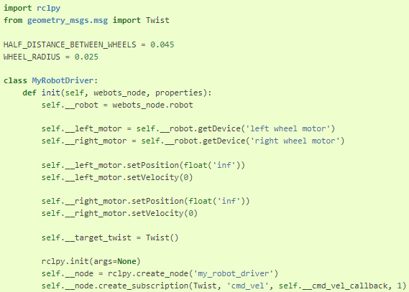
Setting up a robot simulation
Step 2: Setup the simulation
You will need a world file containing a robot to launch your simulation. Download this file
This is actually a fairly simple text file you can visualize in a text editor. A simple robot is already included in this my_world.wbt world file.
Step 3: Change the my_root_driver.py file
The webots_ros2_driver sub-package automatically creates a ROS 2 interface for most sensors. In this task, you will extend this interface by changing the my_robot_driver.py file.
Open my_package/my_package/my_robot_driver.py in your favorite editor and replace its contents with the following:

Slide 24
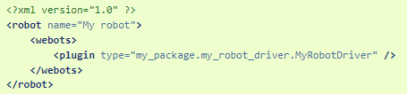
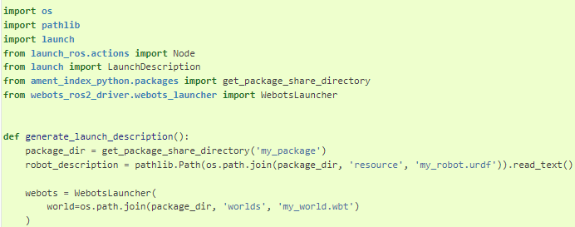
Setting up a robot simulation
Create the my_robot.urdf file
You now have to create a URDF file to declare the my_robot_driver.py
In the my_package/resource folder create a text file named my_robot.urdf with this contents:
Create the launch file
Create now the launch file to easily launch the simulation and the ROS controller with a single command. In the my_package/launch folder create a new text file named robot_launch.py with this code:

Slide 25
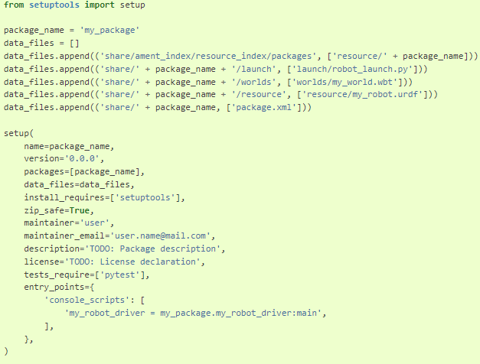
Setting up a robot simulation
Step 6: Modify the setup.py file
Finally, before you can start the launch file, you have to modify the setup.py file to include the extra files you added. Open my_package/setup.py and replace its contents with:
This sets-up the package and adds in the data_files variable the newly added files: my_world.wbt, my_robot.urdf and robot_launch.py.

Slide 26

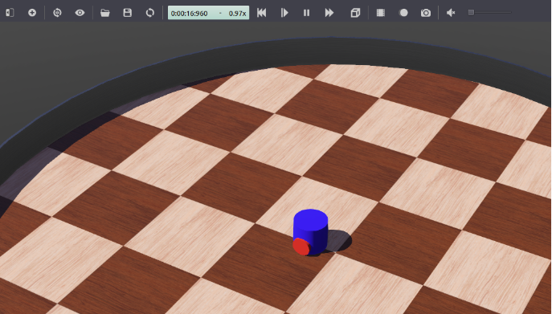
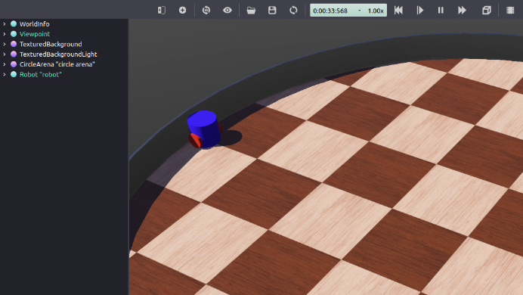
Setting up a robot simulation
Step 7: Test the code
From a terminal in your ROS2 workspace run:\
This will launch the simulation. Webots will be automatically installed on the first run in case it was not already installed.
Then, open a second terminal and send a command with:
ros2 topic pub /cmd_vel geometry_msgs/Twist "linear: { x: 0.1 }"

Slide 27
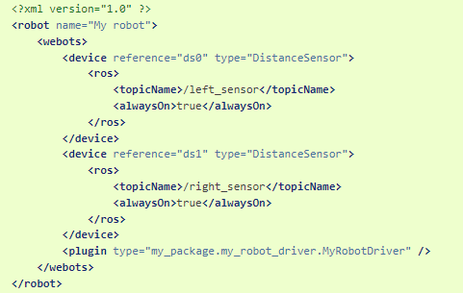
Setting up a robot simulation
Step 8: Updating my_robot.urdf
You have to modify the URDF file in order to enable the sensors. In my_robot.urdf replace the whole contents with:
The ROS 2 interface will parse the <device> tags referring to the DistanceSensor nodes and use the standard parameters in the <ros> tags to enable the sensors and name their topics.

Slide 28
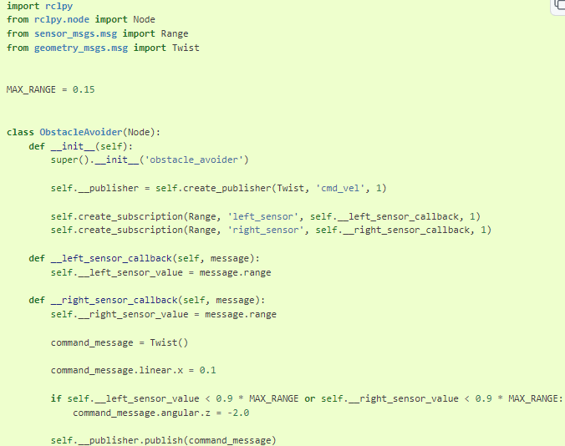
Setting up a robot simulation
Step 9: Creating a ROS node to avoid obstacles
The robot will use a standard ROS node to detect the wall and send motor commands to avoid it. In the my_package/my_package/ folder, create a file named obstacle_avoider.py with this code:

Slide 29

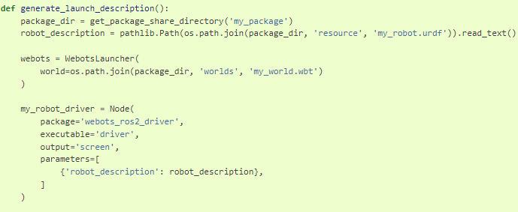
Setting up a robot simulation
Step 10: Updating setup.py and robot_launch.py
You have to modify these two other files to launch your new node. Edit setup.py and replace 'console_scripts' with:
Go to the file robot_launch.py and replace def generate_launch_description(): with:

Slide 30

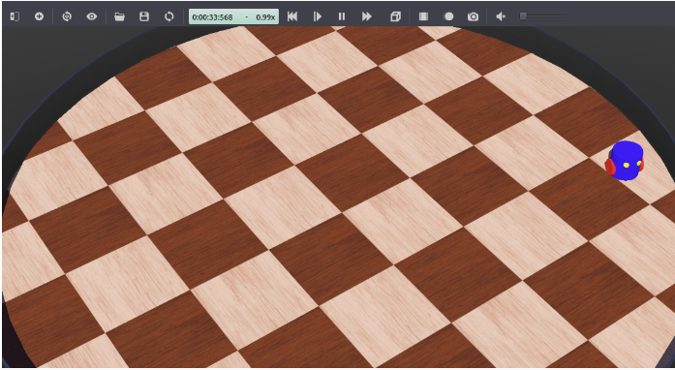
Setting up a robot simulation
Step 11: Test the obstacle avoidance code
As in step 7, launch the simulation from a terminal in your ROS 2 workspace:
Your robot should go forward and before hitting the wall it should turn clockwise. You can press Ctrl+F10 in Webots or go to the View menu, Optional Rendering and Show DistanceSensor Rays to display the range of the distance sensors of the robot.

Slide 31
Brief break (if on schedule)
Q&A?
Prof. Mehdi pirahandeh
E-mail : mehdi at inha dot ac dot kr

